Slide 1

Case Study – Resolvr

Slide 2
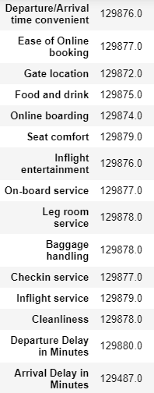

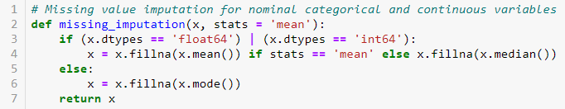

What approach/technique will you use to plug missing datapoints?
Continuous Variables : Missing Imputation with mean value.
Categorical Variables(ordinal & nominal) : Missing imputation with mode value
First continuous and nominal categorical variables are separated out and then using thus UDF missing values are imputed.
UDF for imputing missing values in ordinal categorical variables.

Slide 3

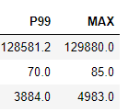

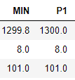
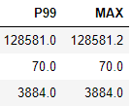

Identify outliers and suggest appropriate action, if required
There are outliers present in the data for some variables like Flight Distance, Arrival Delay in Minutes, Departure Delay in Minutes, which we identify using the quantiles.
To overcome this issue , we use clipping method and clip the lower value to quantile 1 and higher value to quantile 99.

Slide 5
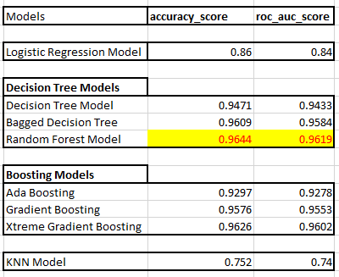
Suggest modelling techniques that can be used to predict the solution in this particular case
Different modelling techniques used and their accuracies are given below:

Slide 6
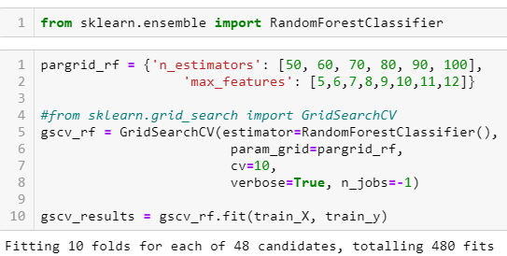

State how you will validate your model
Best Model comes out is RANDOM FOREST MODEL.
In Random Forest Model, as hyper-parameters we only control number of decision trees(which are aggregated) and number of maximum features used for modelling which gives the best model.
With hyper-parameters we are cross-validating ( using 10 folds ) the model using GridSearchCV.
For measuring accuracies, we are using accuracy_score and roc_auc_score.
Accuracy Score :
ROC_AUC Score :

